Slide 1
Migration of Data to Intermediate layers (Part 2)
In this we are going to migrated(copy) data to intermediate layers(ABS > ADLS,etc) of specific/particular time like last one hour or last 2 days.

Slide 2
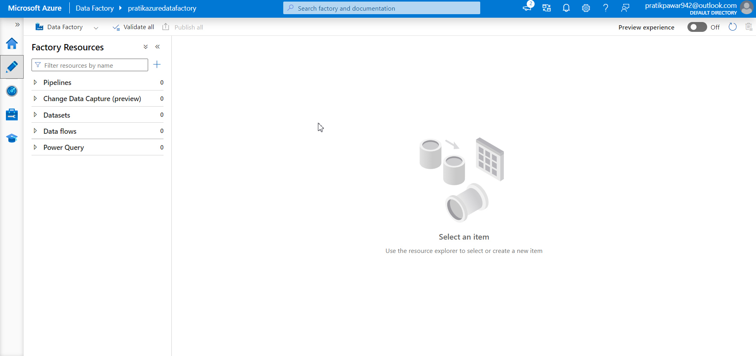
Assume the Azure Blob Storage initial, ADF and Azure blob storage intermediate acc are created

Slide 3
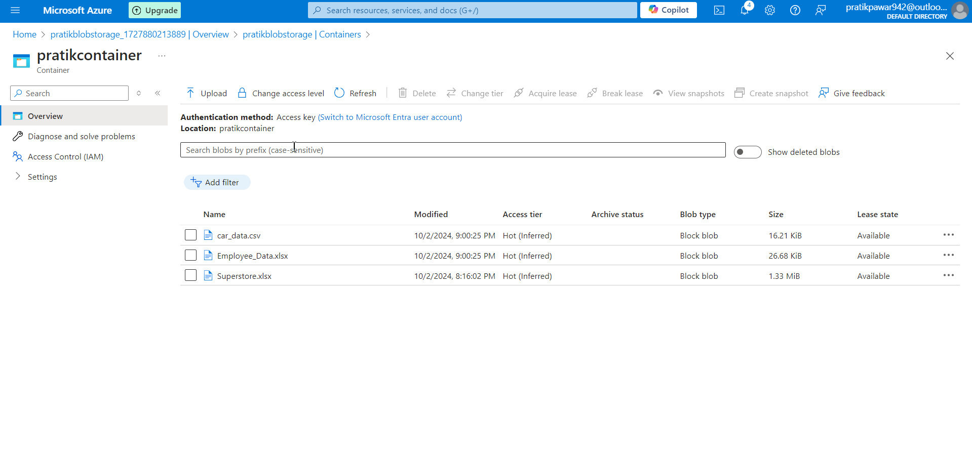
Here, one file is uploaded at 8:16 and other 2 files at 9. So we have to load only 2 files which are uploaded at 9.

Slide 4
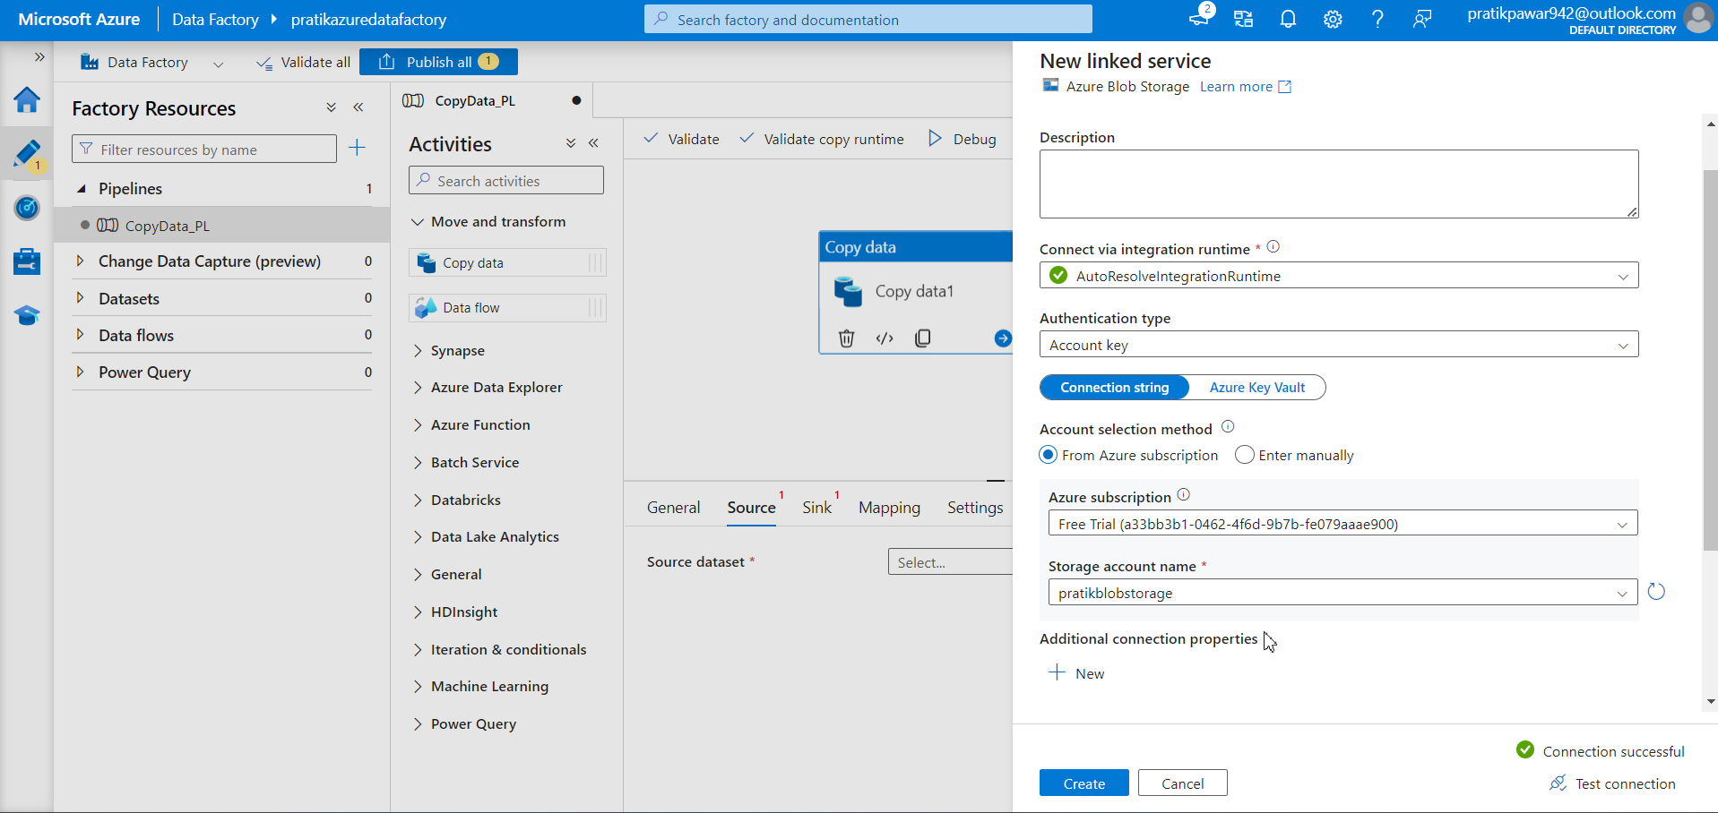
Create pipeline > copydata > add source

Slide 5
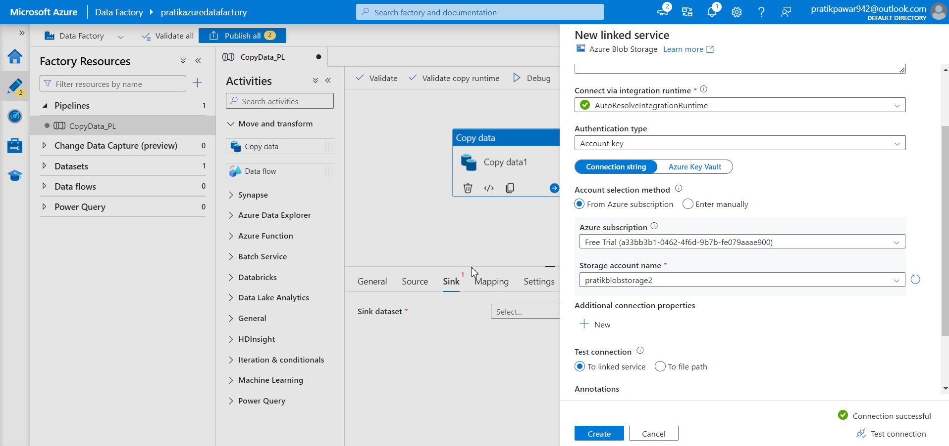
Add sink

Slide 6
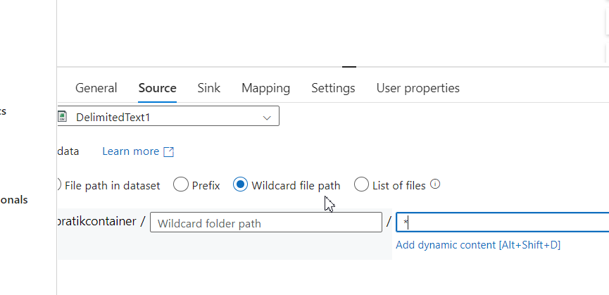
Select Wildcard File path and type * to load all files

Slide 7
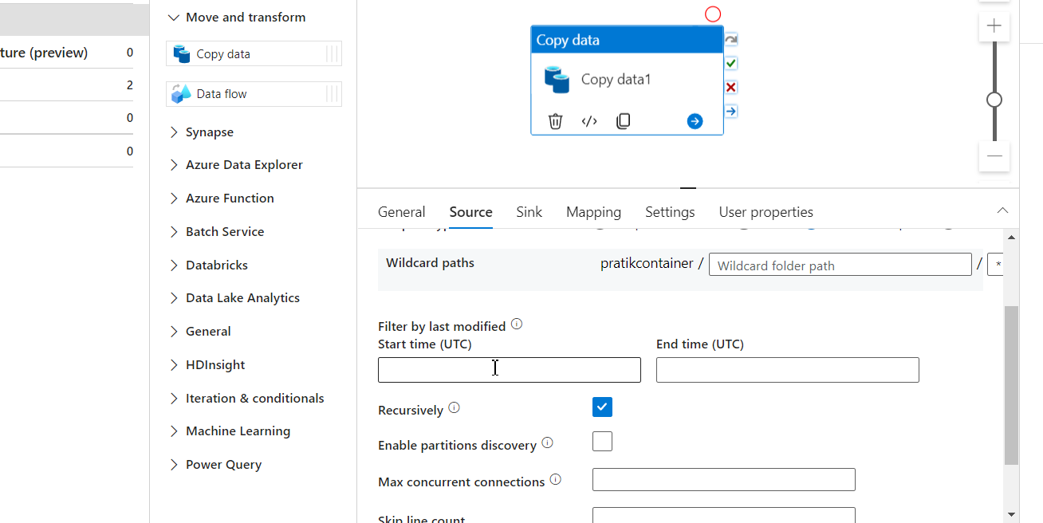
Now go to Filter by last modified

Slide 8
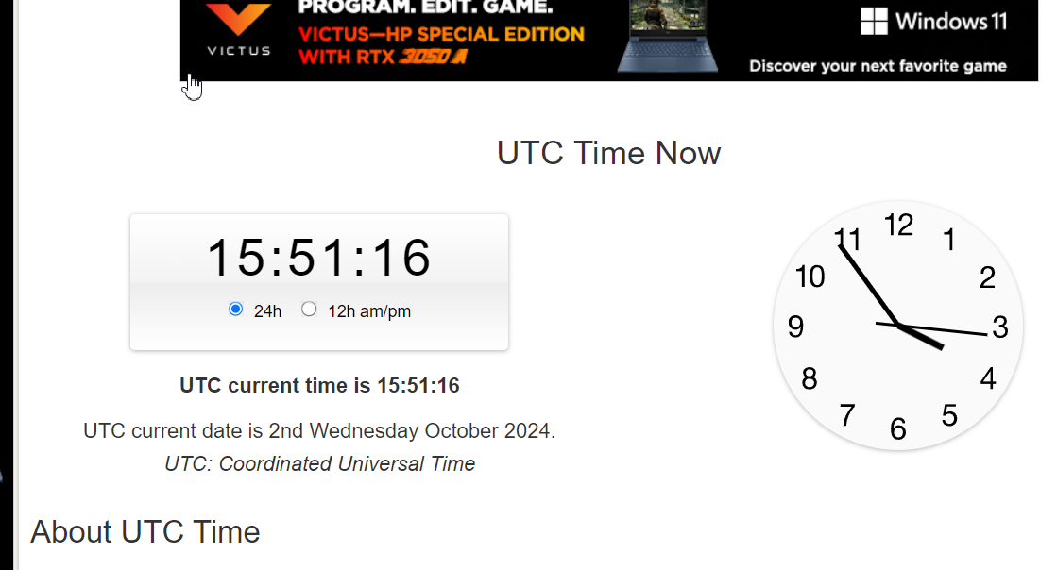
As the time we have select in UTC check Utc time now on Google in 24 hr format

Slide 9
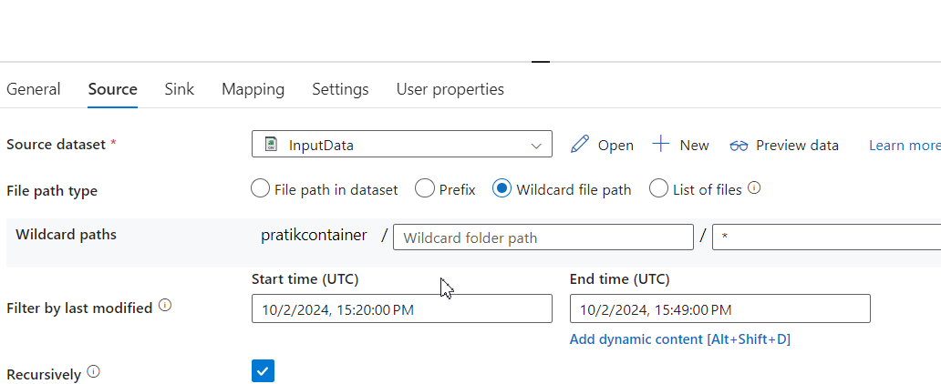
Type End type as UTC time now as it is current time

Slide 10
Write start time 15 min back as we upload before 9 min back

Slide 11
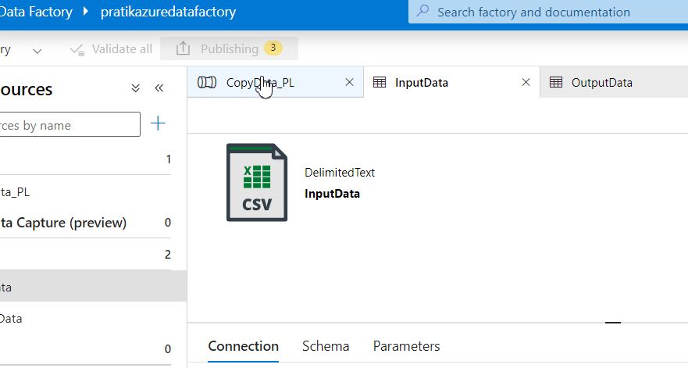
Publish

Slide 12
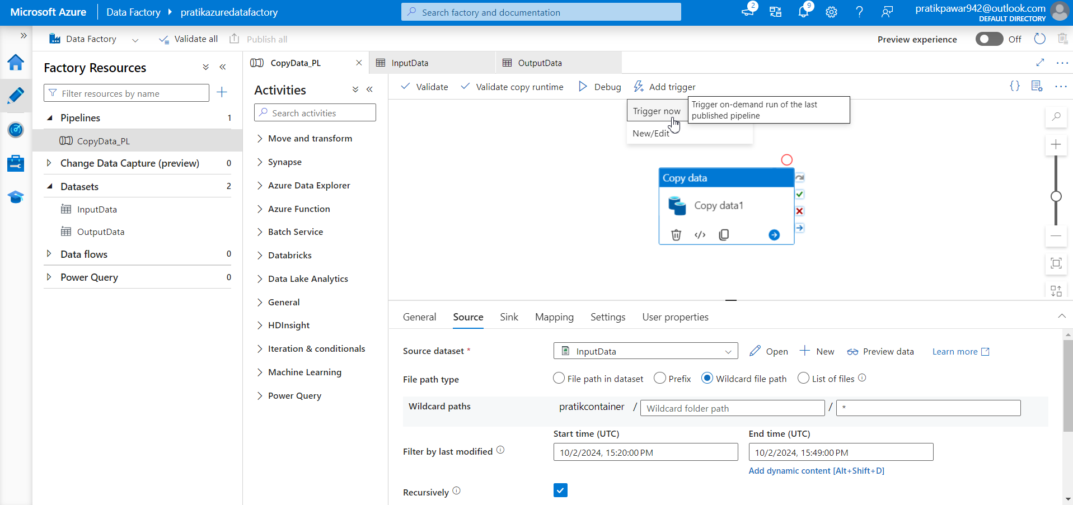
Trigger Now

Slide 13
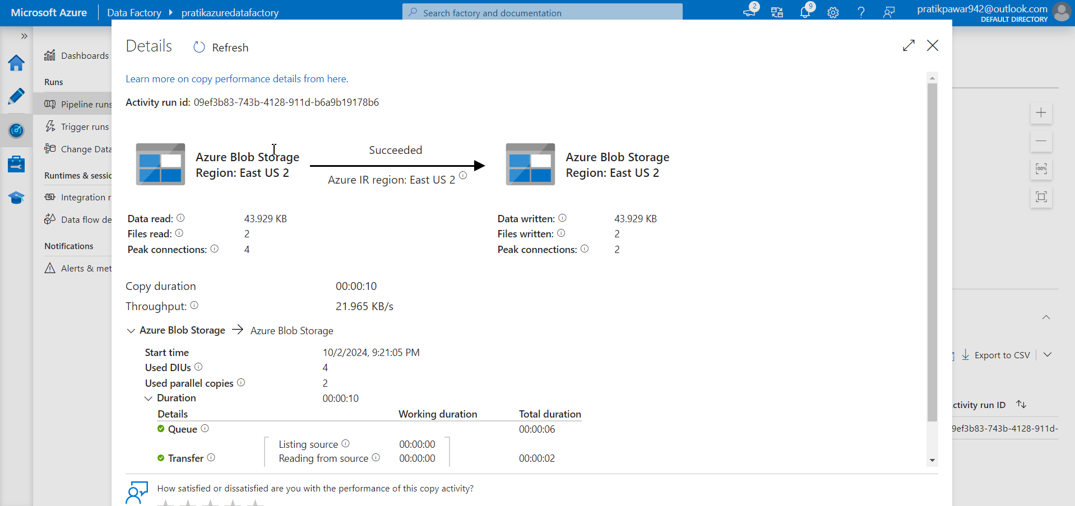
Here only two files have been uploaded at 9 and another one

Slide 14
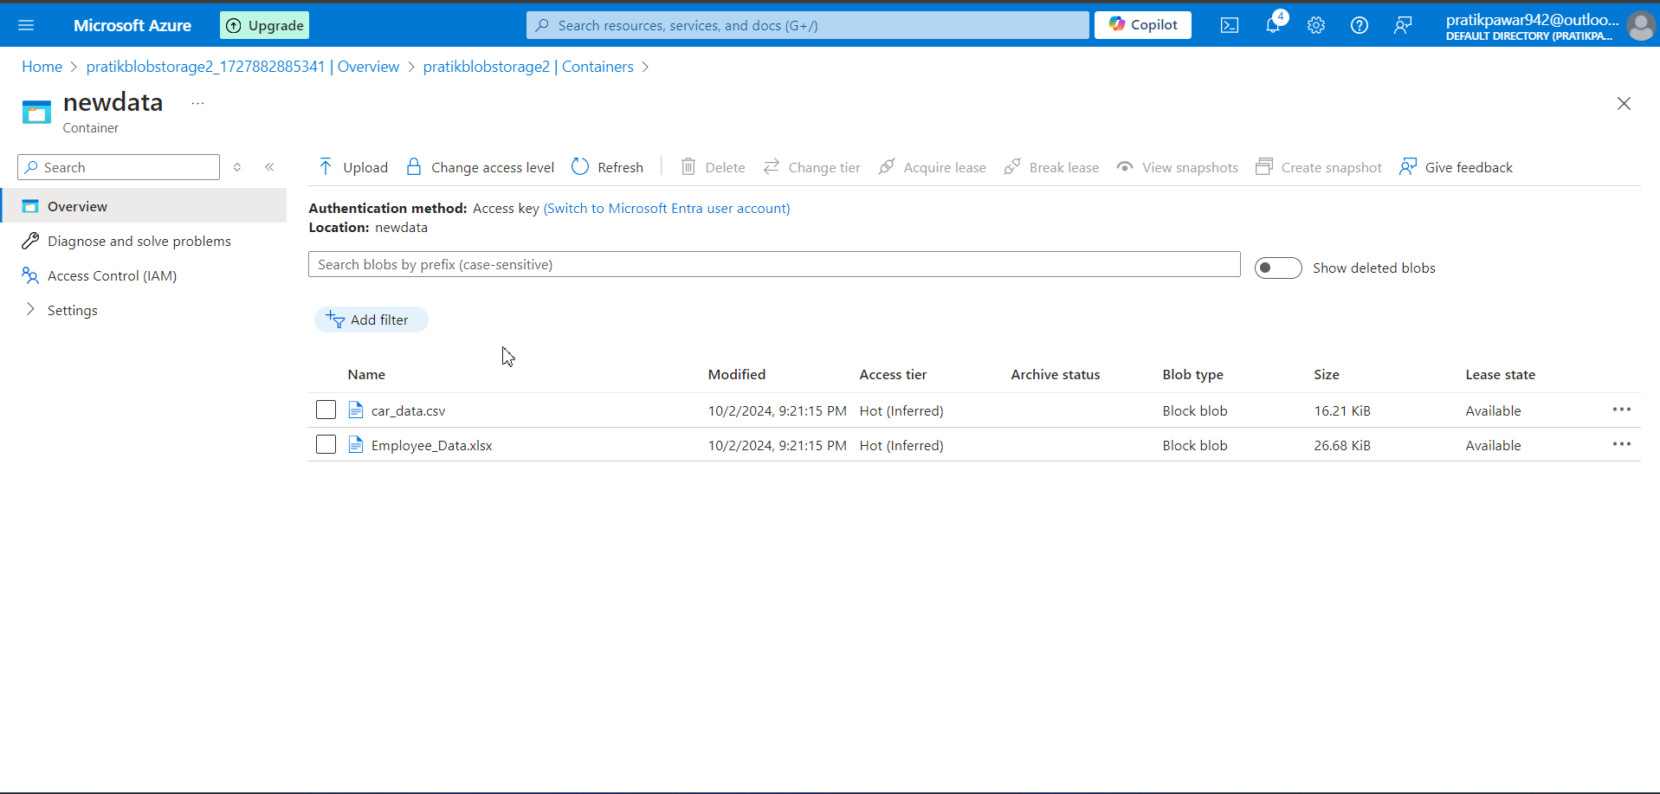
2 files are uploaded but what if we have to upload files 2 days back or 1 day back

Slide 15
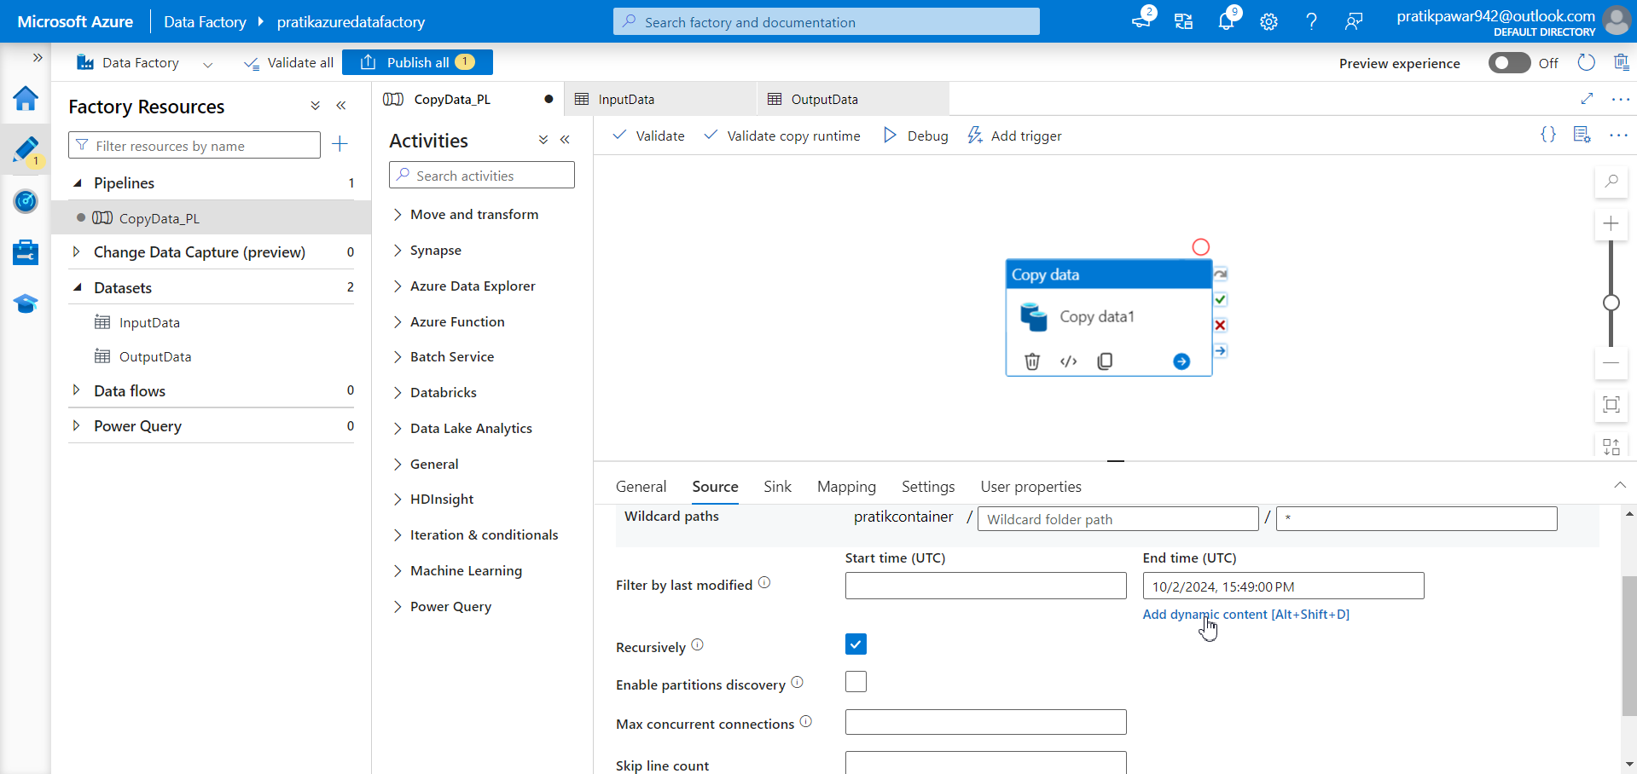
Just Go to EndTime > Add Dynamic Content

Slide 16
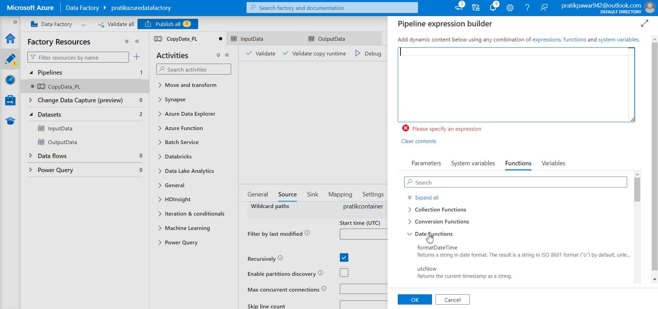
Go to Function > Date functions

Slide 17
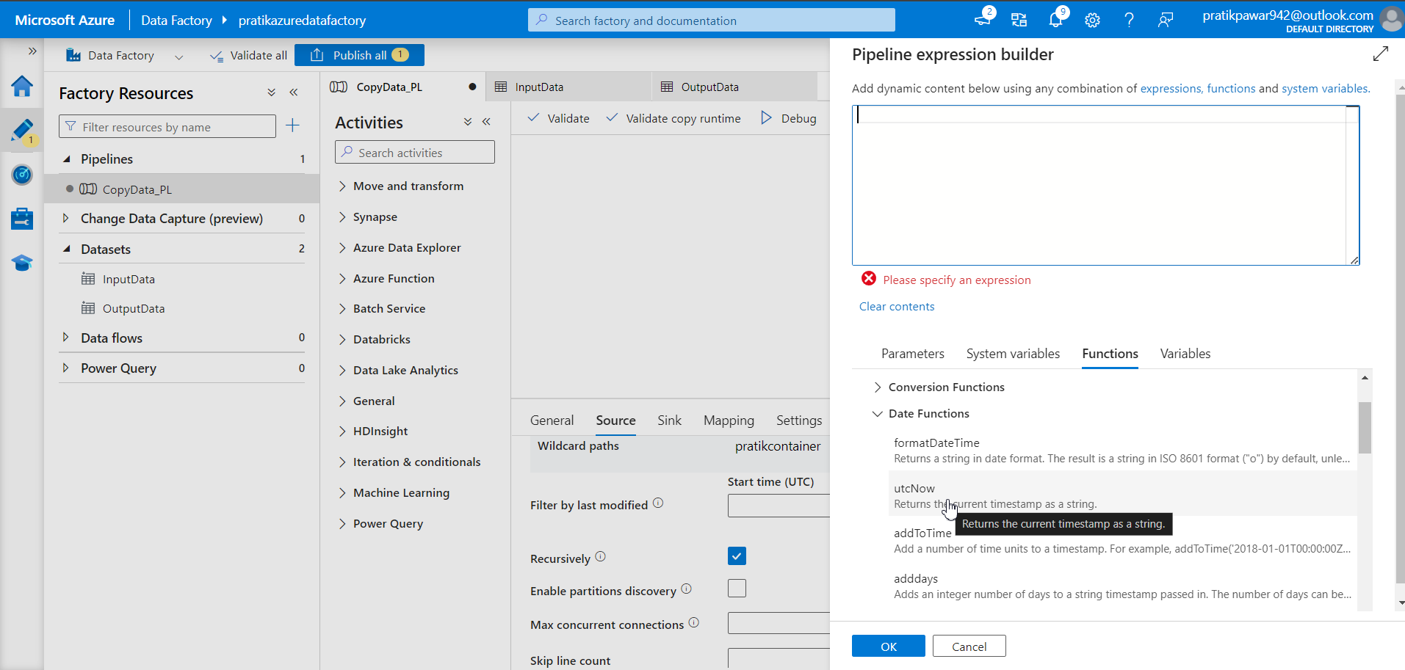
Select utcnow() for Current Date and ok

Slide 18
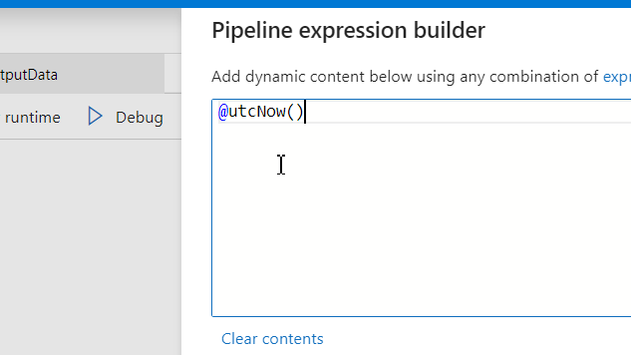
Also remove @

Slide 19
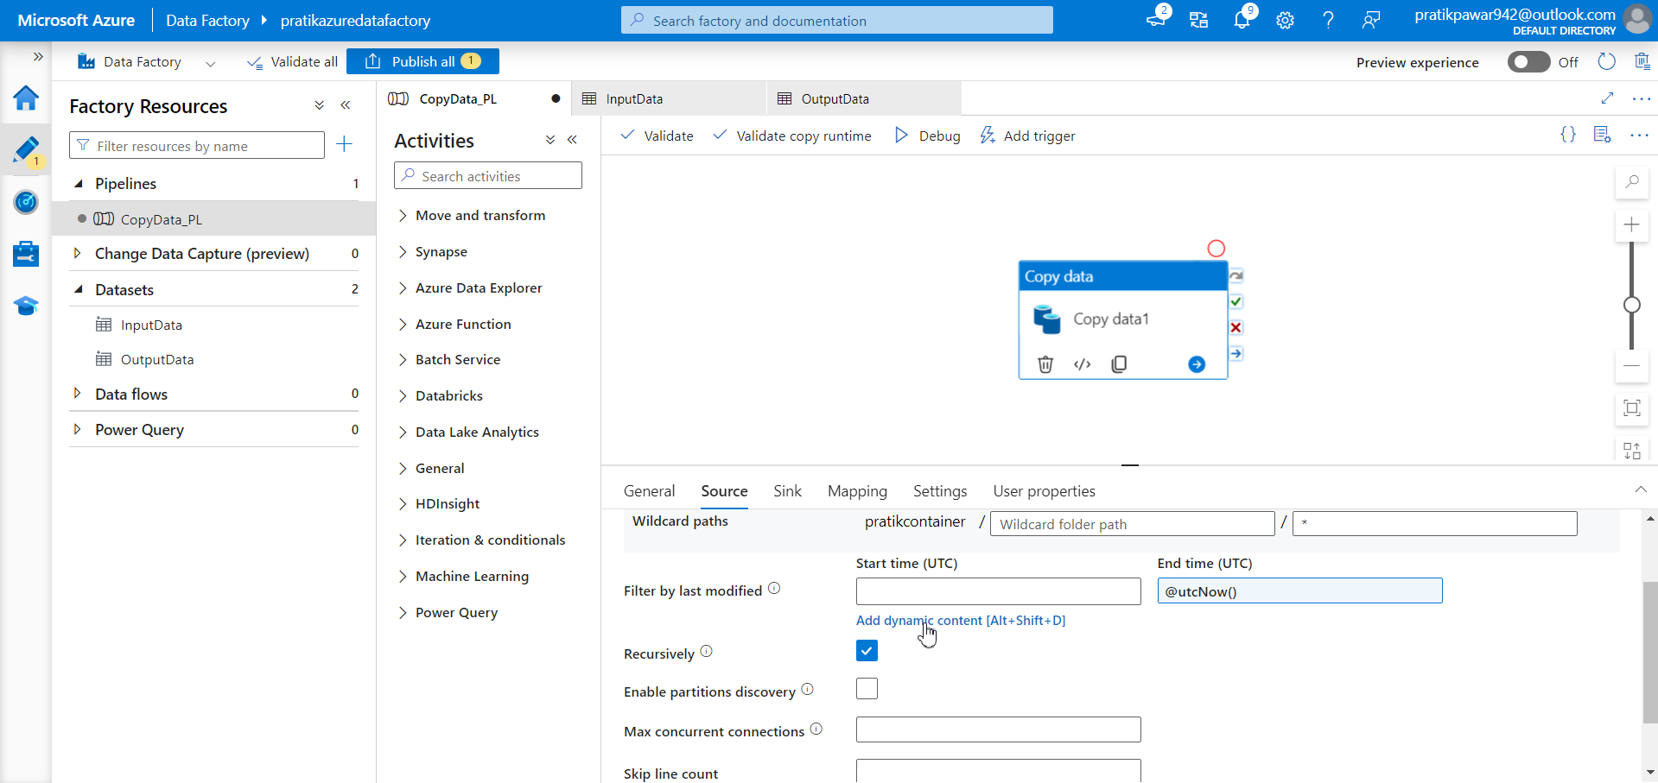
Now start time > add Dynamic Content

Slide 20
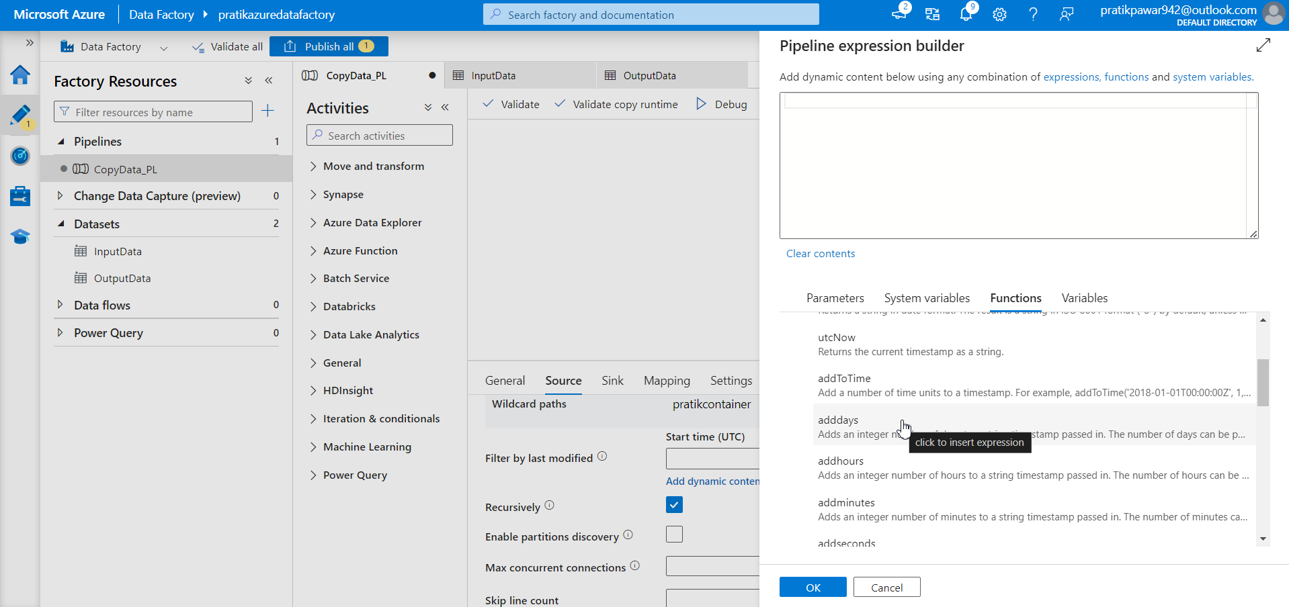
Go to ‘adddays’

Slide 21
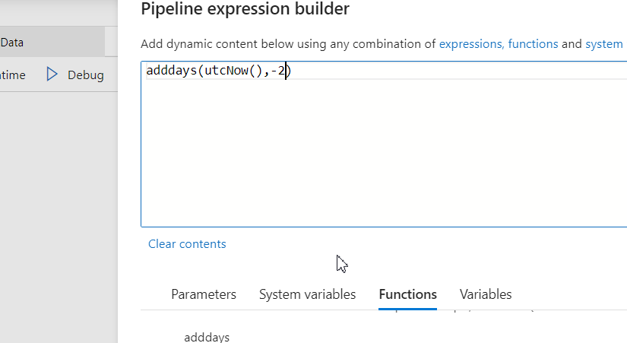
Now we have add utcNow() for current day and ‘-2’ for substracting 2 days from current day so it will be 2 days back

Slide 22
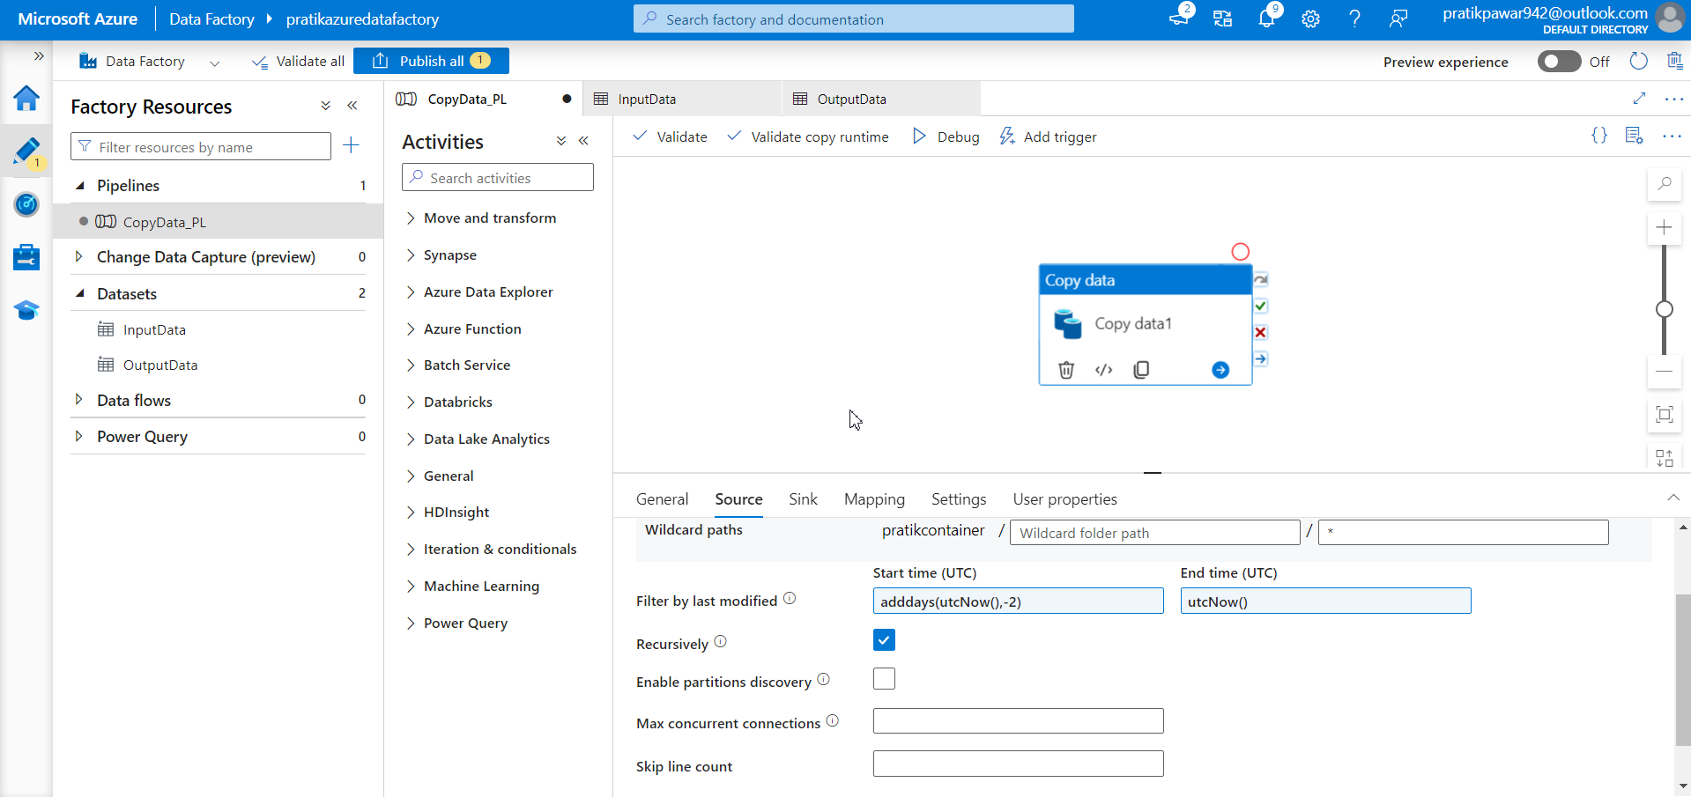
Similarly -1 for one day back. Now just Trigger to load data of 2 days back

